Slide 1
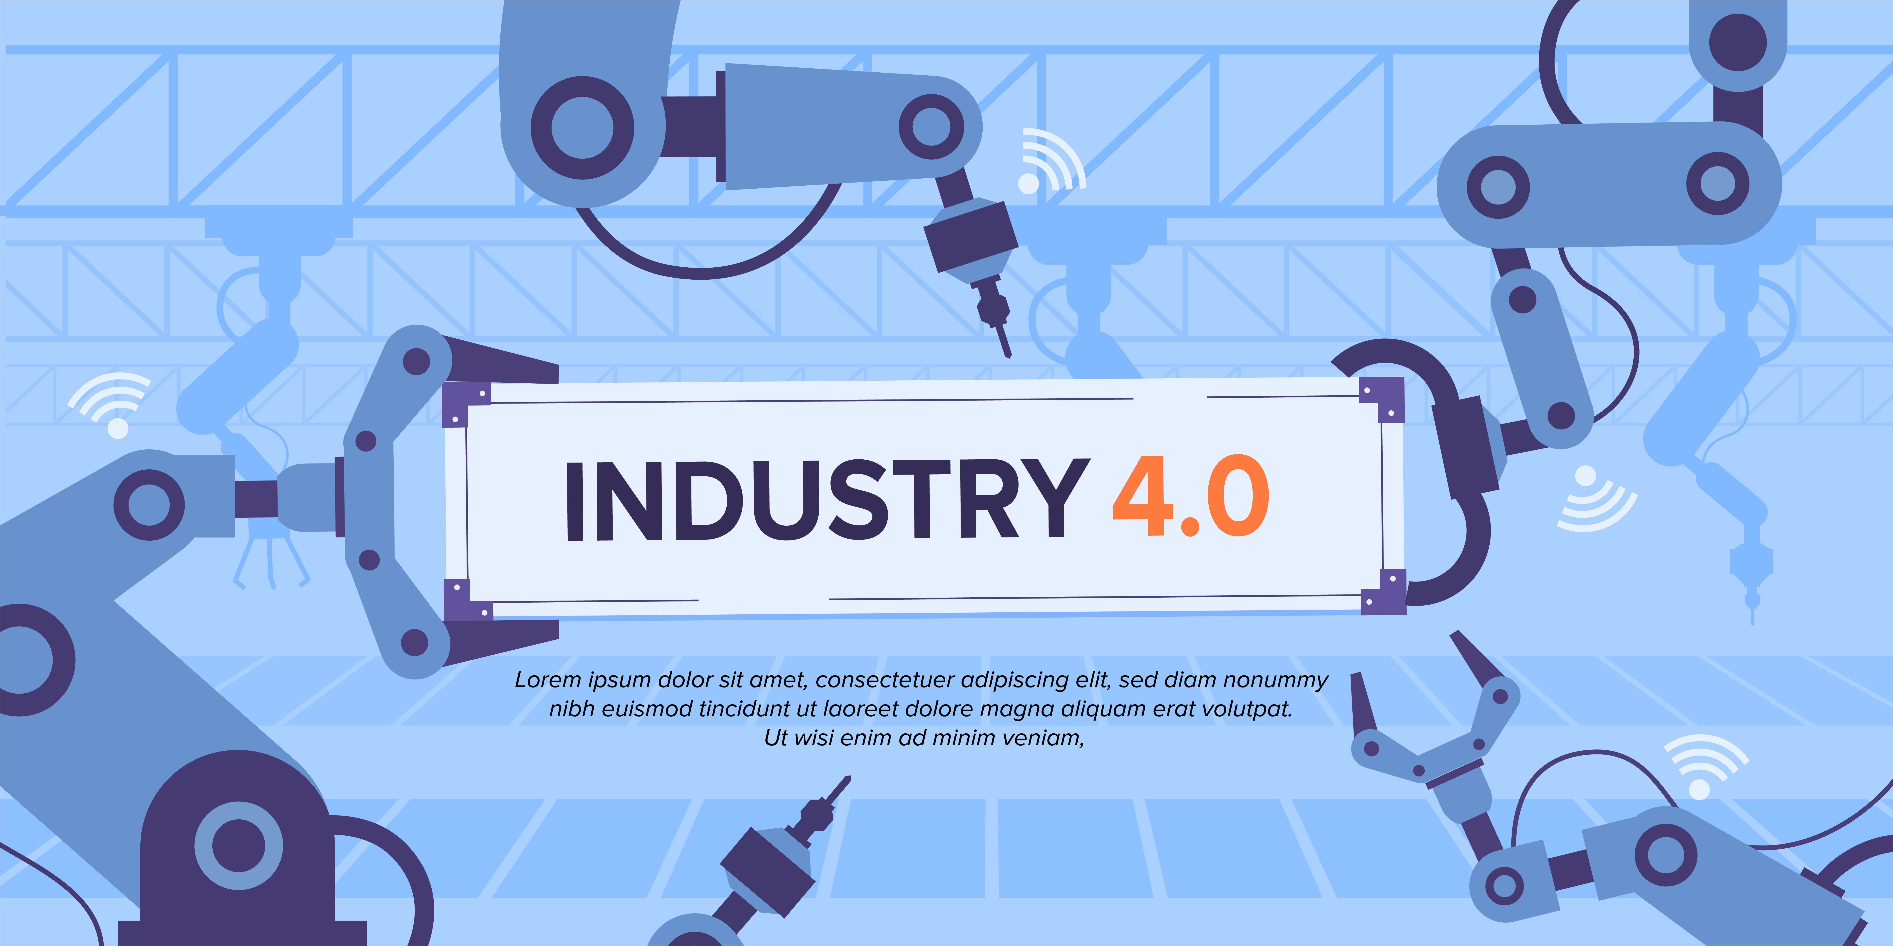
AI for the Industry 4.0 - model
Images from https://www.freepik.com/

Slide 2
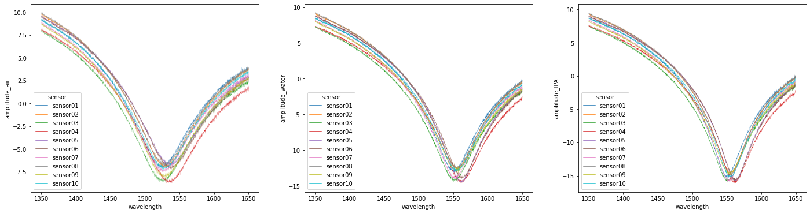
Collection of measurements based on 10 sensors

Slide 3
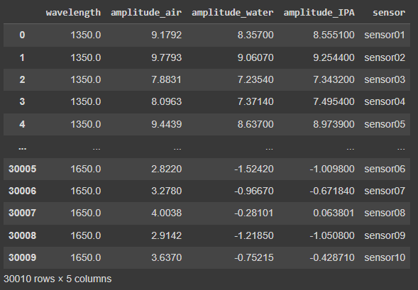
Table with all measurements

Slide 4
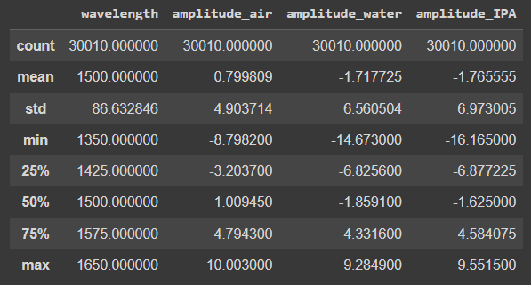
Basic metrics

Slide 5
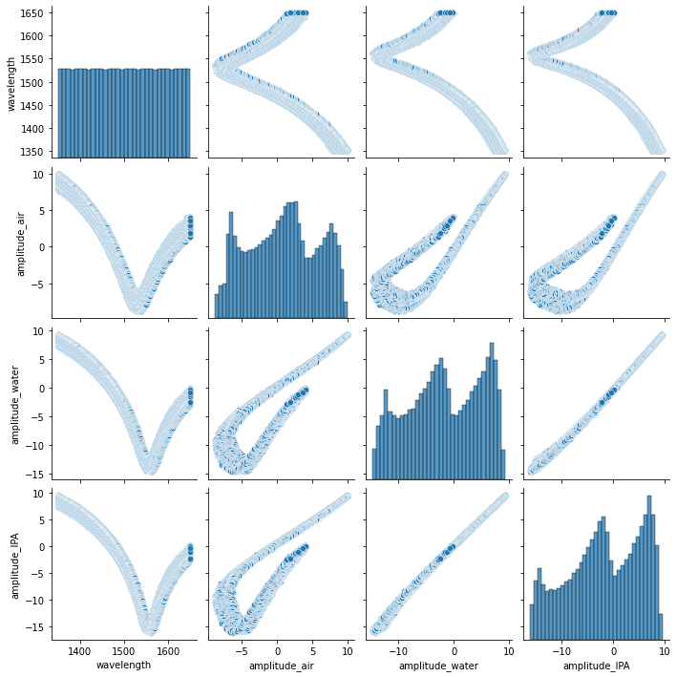
Dependences between features

Slide 6
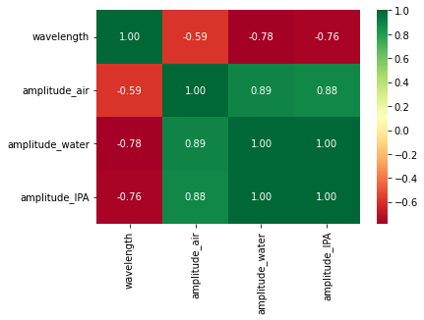
Correlation matrix

Slide 7
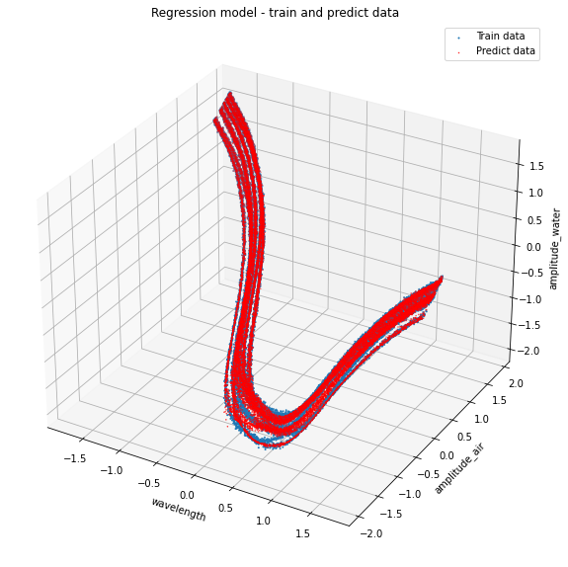
Polynomial regression for prediction of characteristics in water
Polynomial degree: 14
R2: 0,9974

Slide 8
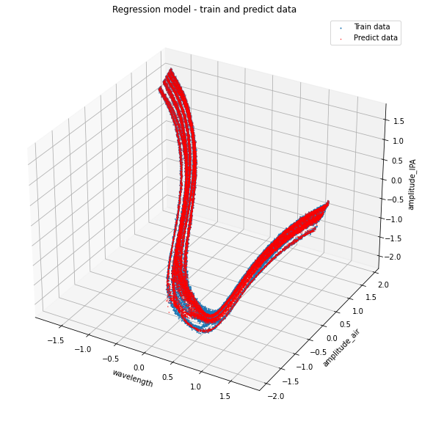
Polynomial regression for prediction of characteristics in isopropanol
Polynomial degree: 14
R2: 0,9969

Slide 9
Different approach
Predict characteristics of a working sensor in air and isopropanol based on measured characteristics in water.

Slide 10
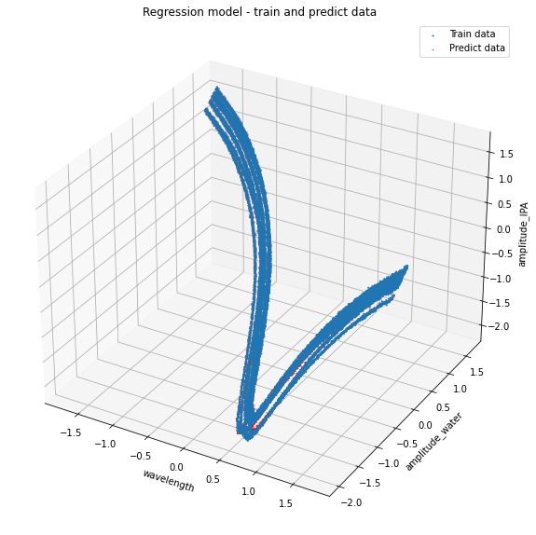
Polynomial regression for prediction of characteristics in isopropanol based on characteristics in water
Polynomial degree: 14
R2: 0,9993

Slide 11
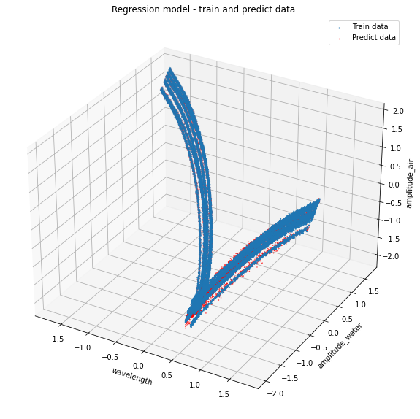
Polynomial regression for prediction of characteristics in air based on characteristics in water
Polynomial degree: 14
R2: 0,9965

